Slide 1

SIEM Deployment and
logs check reachability

Slide 2
Project Overview & Objectives
Goal: Build a complete SIEM environment using open-source Elastic Stack to collect, analyze, and monitor security logs.
Scope:
Central Elasticsearch + Kibana
Fleet Server to manage agents (Ubuntu server)
Windows VM (Asus)
Linux VM (kali)
Fleet Server VM (mohamed-el7oot)
KPIs:
Collect logs from all endpoints
Detect security events (e.g., process creation)
Centralized visibility in Kibana

Slide 3
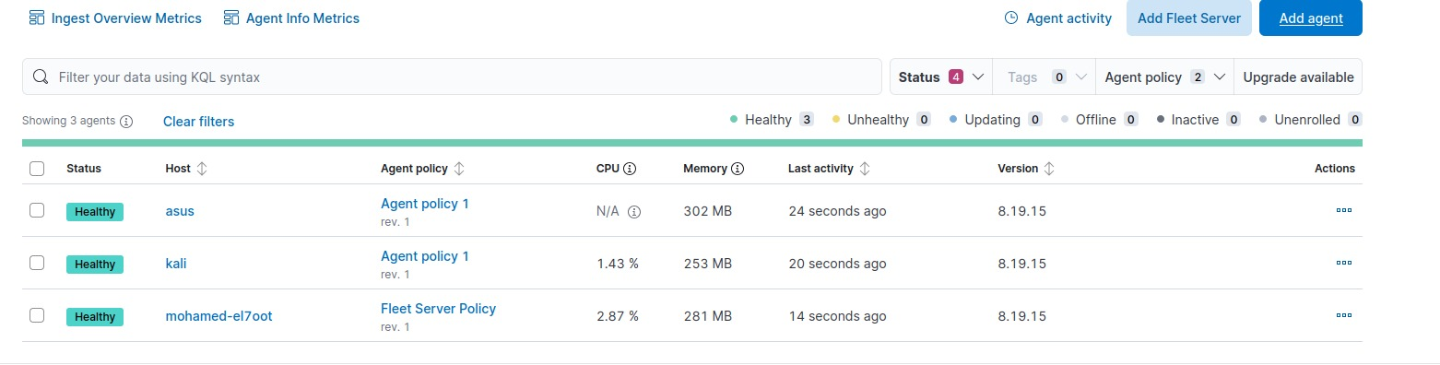
Architecture Overview
>> Devices used and their IPs
1- Elastic Stack Server 192.168.190.131
• Elasticsearch (port 9200)
• Kibana (port 5601)
•Fleet Server

Slide 4
Architecture Overview
2- Linux 192.168.190.128
attacker device used to deploy some attacks on devices
by beast using of vulnerabilities
3- Windows 192.168.190.1
Employee devices are vulnerable to attacks and need protection
NOTE :
I got IPs
• using (ip a ) on command line,
• using (ipconfig) on CMD

Slide 5
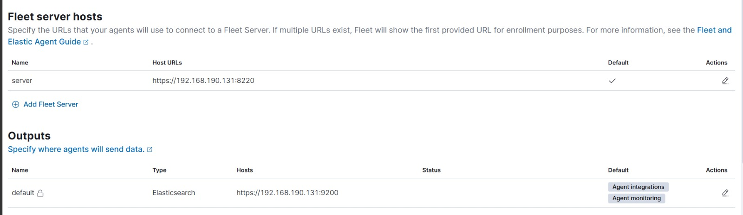
Fleet Server

Slide 6
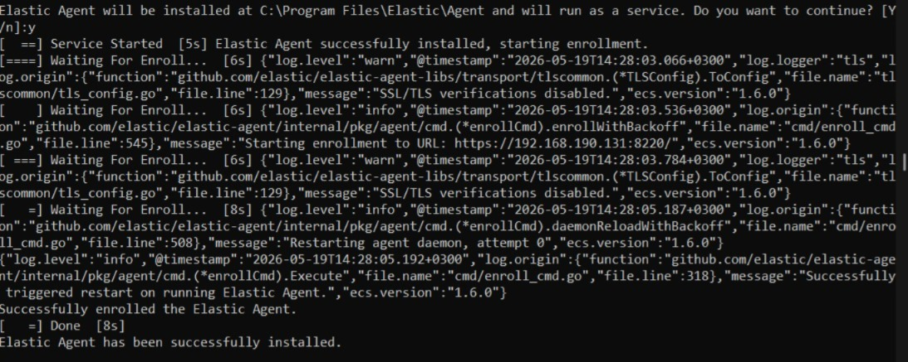
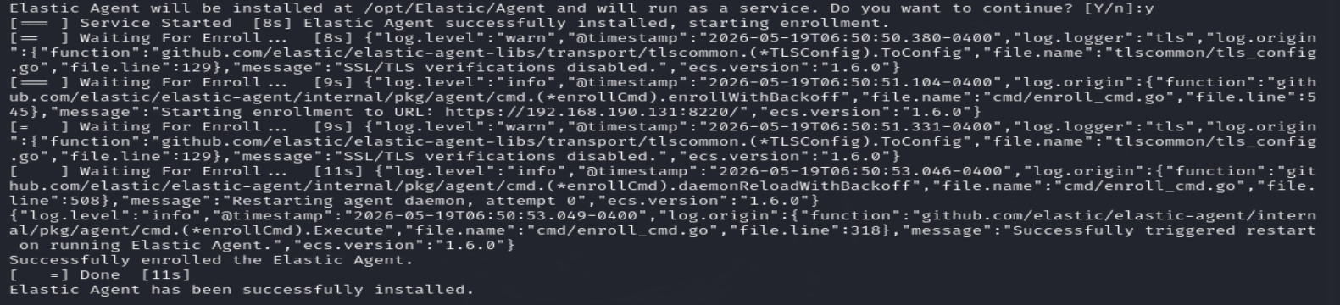
installation of Elastic Agents
> successfully installed at windows
> successfully installed at Linux

Slide 7
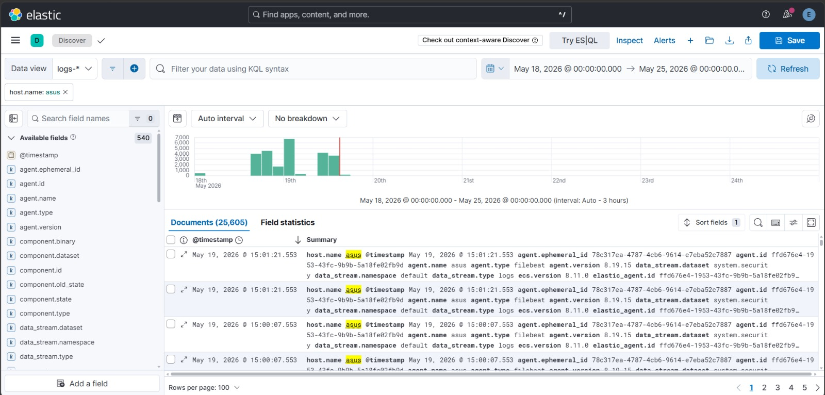
Windows Logs Analysis
All logs indexed under "logs-*" data view

Slide 8
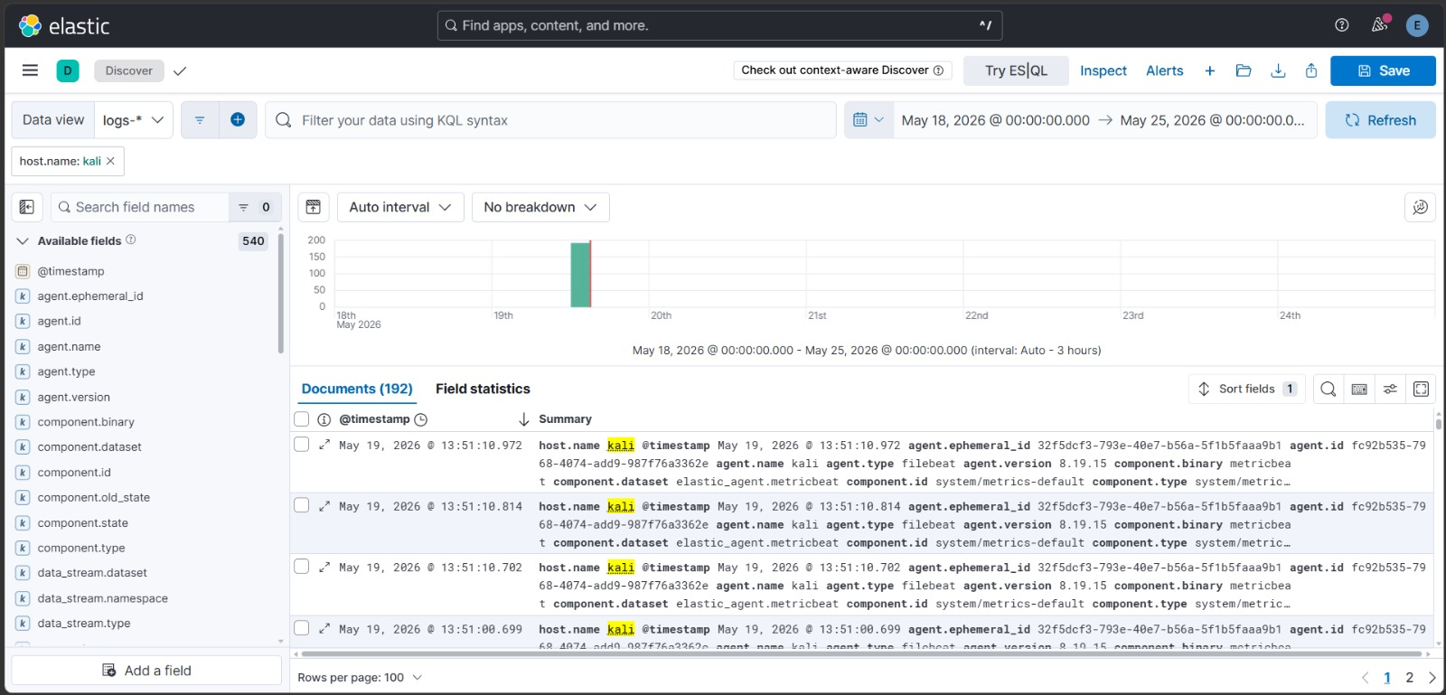
Linux Logs Analysis (kali)

Slide 9
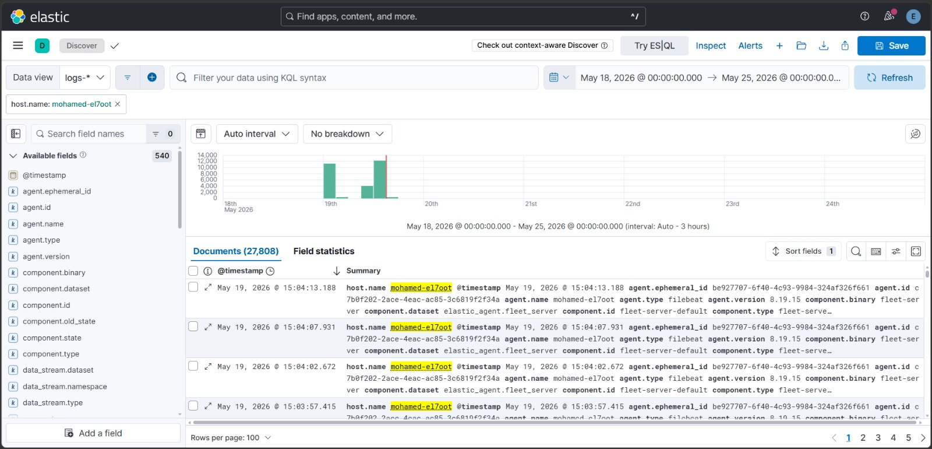
Fleet Server Internal Logs

Slide 10
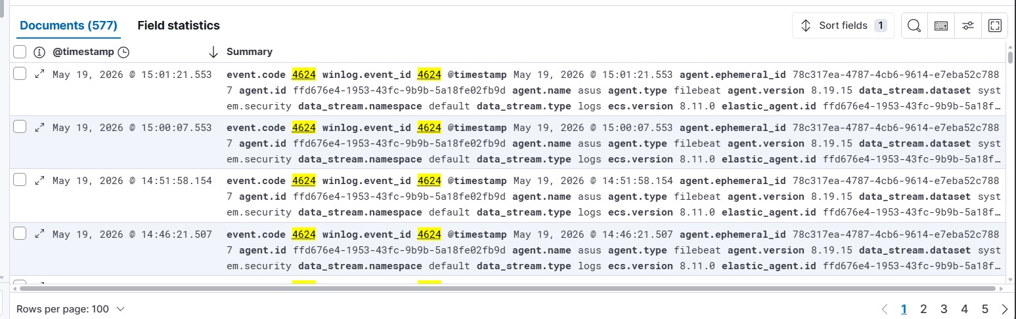
Security Event Examples
1- Event ID 4624 (Successful Logon)
, which is crucial for tracking the attacker's lateral movement or successful access. Additionally,
2-Event ID 4625 (Failed Logon) will help us detect and analyze the Brute Force attack attempts.

Slide 11
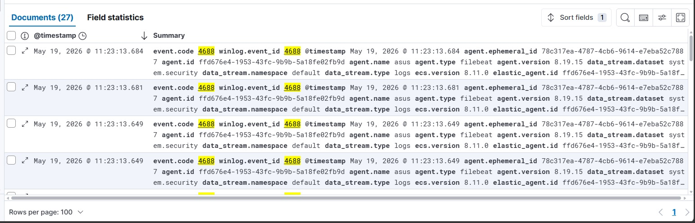
3- Event ID 4688 (Process Creation) This allows us to monitor any application launch or any command executed via CMD or PowerShell
This event ID is not enough if attacker uses Obfuscation (تشفير أو تمويه للأكواد)
so we use :
4- Event ID 4104 (Script Block Logging)
To get full visibility into PowerShell executions, which logs the actual content of the scripts and commands being executed, defeating most obfuscation techniques

Slide 12
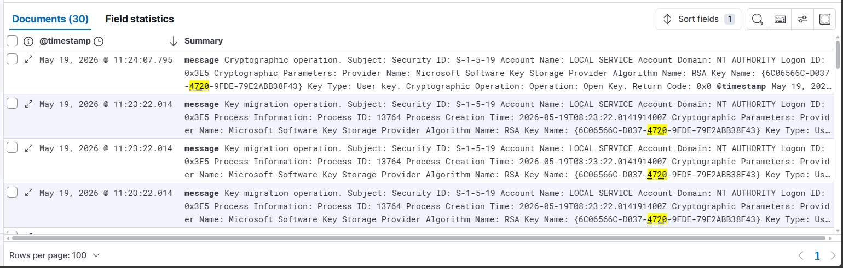
5-Event ID 4720: A user account was created
6-Event ID 4732: A member was added to a security-enabled local group (e.g., Administrators)

Slide 13
>>
Log filtering allows you to isolate specific events or analyze data within defined time periods

